Slide 1
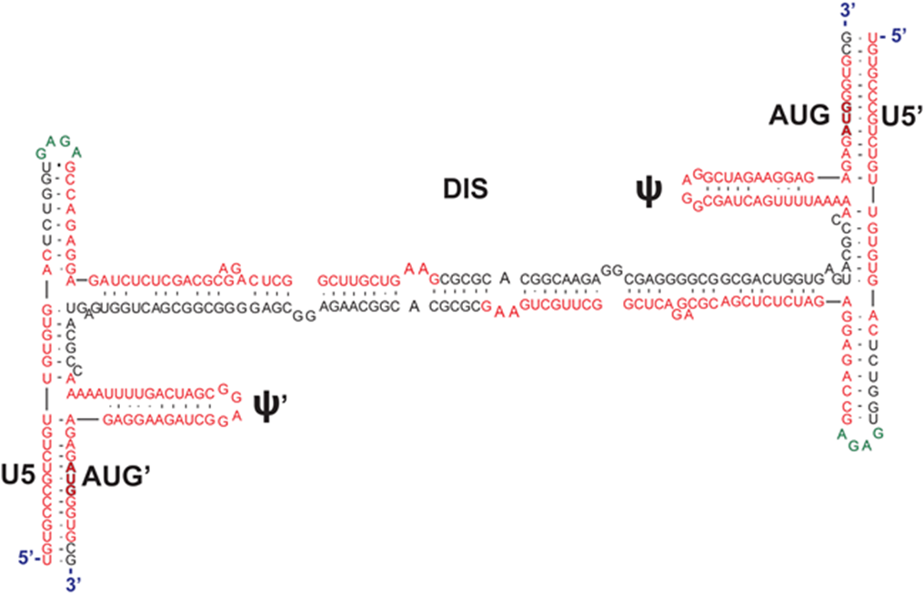
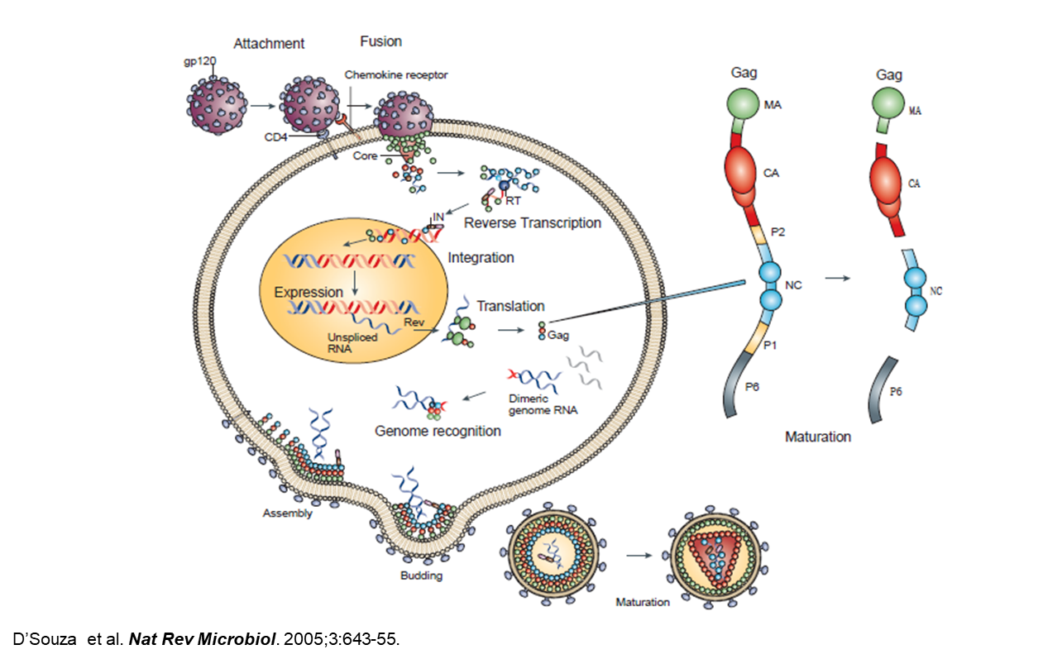
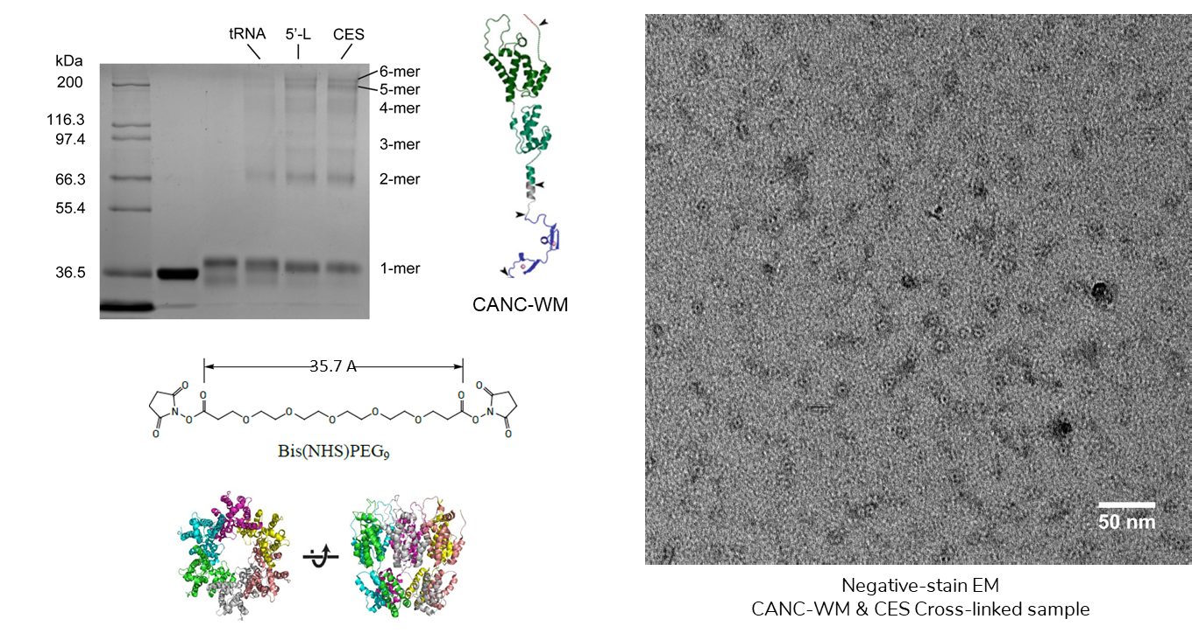
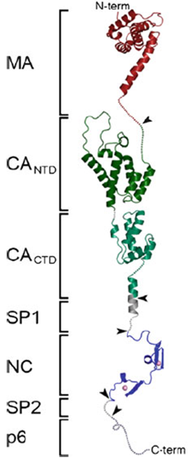
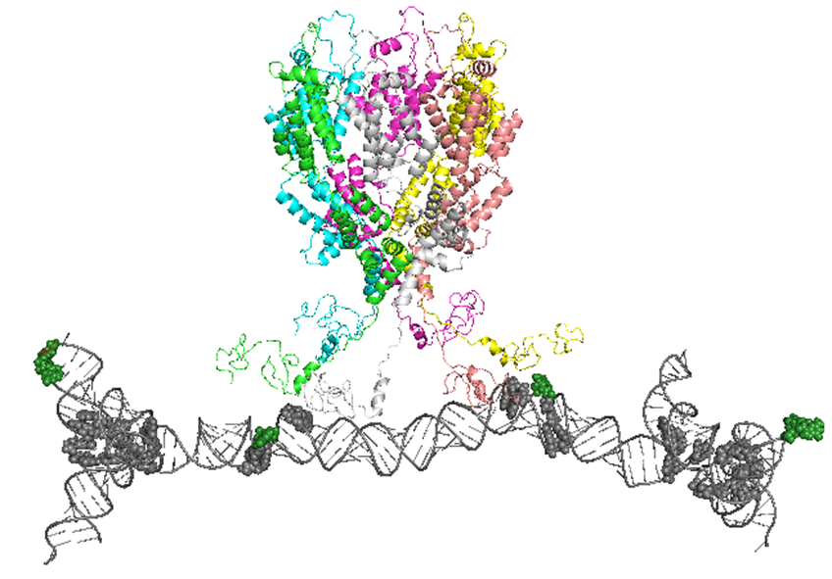
Characterization of the Protein-RNA Interactions that Nucleate the HIV-1 Virus Assembly
Ciairra J. Riley¹, Sapna Basappa², Alexis Waller², Nansen Kuo², Aaron Kidane², Mitali Sarkar², Pengfei Ding, Ph.D.², and Michael F. Summers, Ph.D.²
¹Department of Biological Sciences, California State University Long Beach, 1250 Bellflower Blvd, Long Beach, CA 90840
²Department of Chemistry and Biochemistry, Howard Hughes Medical Institute, University of Maryland Baltimore County, 1000 Hilltop Circle, Baltimore, MD 21250
Abstract:
The HIV virus infects roughly 40 million people worldwide; the retrovirus compromises the immune system, paving way for other diseases. While there are treatments for this disease, only about half of the people infected receive it, and a fraction of them also have side effects or reject the treatment, making it ineffective. A better understanding of the molecular mechanisms of different processes during the HIV replication cycle will benefit the development of new anti-viral therapeutics. We are focused on studying how Gag can selectively package the viral dimeric genome. Although there is a large excess of non-viral RNA in the cytosol, more than 90% of the progeny virions contain viral genomic RNA. Gag is a multi-domain polyprotein which includes the Matrix (MA), Capsid (CA), and Nucleocapsid (NC) domains. The NC domain of Gag binds to unpaired or weakly base-paired Guanines on the 5’ UTR region of the dimeric RNA genome. We propose that the clustering of Gag proteins on the 5’ UTR promotes the formation of Gag hexamers, which will function as the nucleation site to initiate the assembly of the Gag protein shell.
We seek to characterize the different binding sites on the 5’ UTR that Gag interacts with, as well as providing evidence that the RNA promotes the formation of Gag hexamers. By using gel shift and ITC we located sixteen binding sits in the core encapsidation signal. Chemical crosslinking and electron microscopy reveals that the gag hexamer was formed when bound to RNA. Our ultimate goal is to solve the structure of the Gag/RNA nucleation complex by cryo-electron microscopy, which will reveal the detailed molecular mechanism for HIV selective genome packaging.
Future Work:
a.
b.
c.
Figure 4. Core Encapsidation Signal (CES) ⁴.
Previous studies in the lab have found that the TAR, PolyA, and PBS regions were not needed for Gag binding or genome packaging. It was then confirmed that this is the minimal region for genome packaging.
Figure 6. NC Binding Sites in the Junction Region
a. Secondary structure of the junction region. b. Gel shift and c. ITC indicated that there are at least 5 binding sites within this region.
Background:
a.
b.
Methods:
Gel shift:
Gel shifts are done by gradually changing the protein:RNA ratio. Complex bands will form as protein is added. By counting the number of complex bands it is possible to estimate the amount of binding sites.
Isothermal Titration Calorimetry (ITC)
ITC can confirm the amount of binding sites in a target RNA. The RNA is in a sample cell, and protein is titrated in at certain intervals. By fitting the isotherm curve, the N and $K_{d}$ value can be measured, where N is the number of binding sites and $K_{d}$ is the binding affinity.
Chemical crosslinking
Chemical crosslinking helps to capture the hexamer while viewing on a denaturing gel. We are able to study the oligomerization state of the protein when incubated with viral RNA by using different crosslinkers.
Negative-Stain Electron microscopy (EM)
Electron microscopy was used to directly visualize the shape of the protein oligomer. The sample was stained with uranyl acetate and viewed under a transmission electron microscope.
c.
Figure 7. 5’-Leader and CES promote the formation of CA hexamer
a. A chemical crosslinking and b. negative-stain EM was performed to prove the formation of hexamers (c.).
Figure 1. HIV-1 Replication Cycle¹.
Figure 2. Structure of the Gag polyprotein².
CA domain: protein-protein interactions that result in the formation of the gag hexagonal lattice.
NC Domain: Two zinc finger structures that create two hydrophobic clefts that interact with exposed guanosines on the RNA genome.
Results:
a.
c.
Figure 8. Proposed structure of Nucleation Complex.
We are currently working on structurally characterize this nucleation complex.
b.
Conclusion:
Based on the data shown, we were able to confirm that there are at least sixteen binding sites on the full length CES: 5 in the junction regions and 6 in the DIS region. We also determined that the CES dimer promotes the formation of a Gag hexamer. Some other aspects to focus on for this project is to do more structural study of the RNA and hexamer in order to solve the structure of the nucleation complex.
References:
D’Souza et al. Nat Rev Microbiol. 2005;3:643-55.
Ganser-Pornillos BK, Yeager M, Pornillos O. Adv Exp Med Biol. 2012;726:441-65.
Keane SC, et al. PNAS. 2016 Nov 15;113(46):13033-13038.
Heng et al. J Mol Biol. 2012;417:224-39
Figure 5. NC Binding Sites in the DIS Region.
a. NMR revealed unpaired and weakly paired guanosines in the DIS region which are potential NC binding sites.
b. An electrophoretic mobility shift assay (gel shift) estimated at least 5 binding sites in the DIS region.
c. ITC confirmed that there are 6 binding sites in the DIS region.
Figure 3. Dimeric 5’-Leader³.
Secondary structure of the dimeric 5’ UTR, highlighting it’s symmetrical conformation. The 5’-Leader is highly conserved and structured with different functions.
Acknowledgements:
This research was funded by the NIH/NIGMS grant 1P50GM103297 and the Howard Hughes Medical Institute at UMBC. This research was funded in part by the Summer Biomedical Training Program with funding from the College of Natural Mathematics and Sciences and the Office of the Vice President for Research at UMBC. Support for Ciairra Riley is provided by the National Science Foundation Research Experience for Undergraduates (REU) Research Award CHE-1460653. All research was conducted at the Howard Hughes Medical Institute at UMBC.

